Slide 1
Machine Learning Training
2020 - 2021
Dr. ir. Andrew Katumba,
Lecturer, ECE Department, Makerere Univerisity

Slide 2
Background

Slide 3

Artificial Intelligence, Machine Learning and Deep Learning
A set of techniques that enable machines
to mimic human behavior
A subset of AI techniques that enable machines
to improve with experience
A subset of ML techniques that make the training of multi-layer neural networks feasible
Source: https://www.edureka.co/blog/ai-vs-machine-learning-vs-deep-learning/
Industrial automation

Slide 4
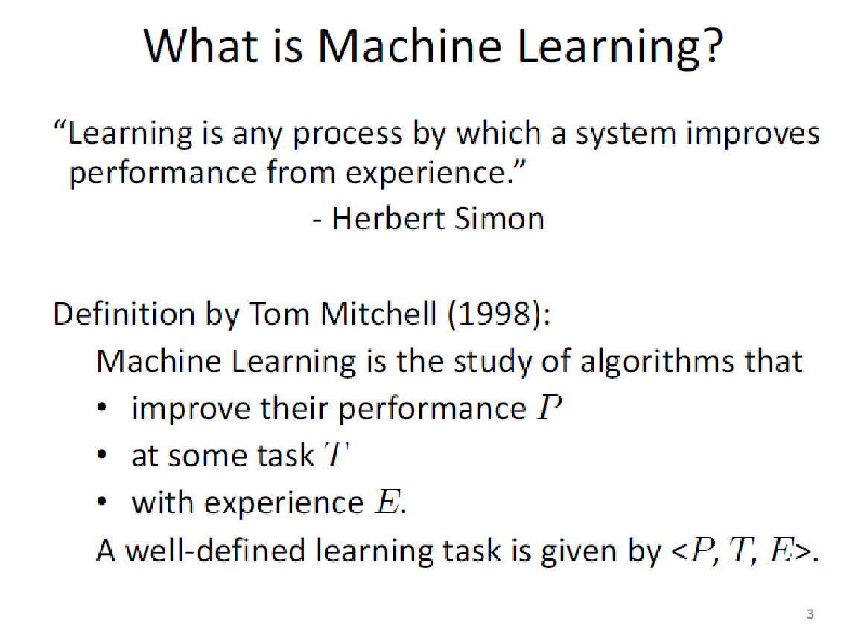

Slide 5
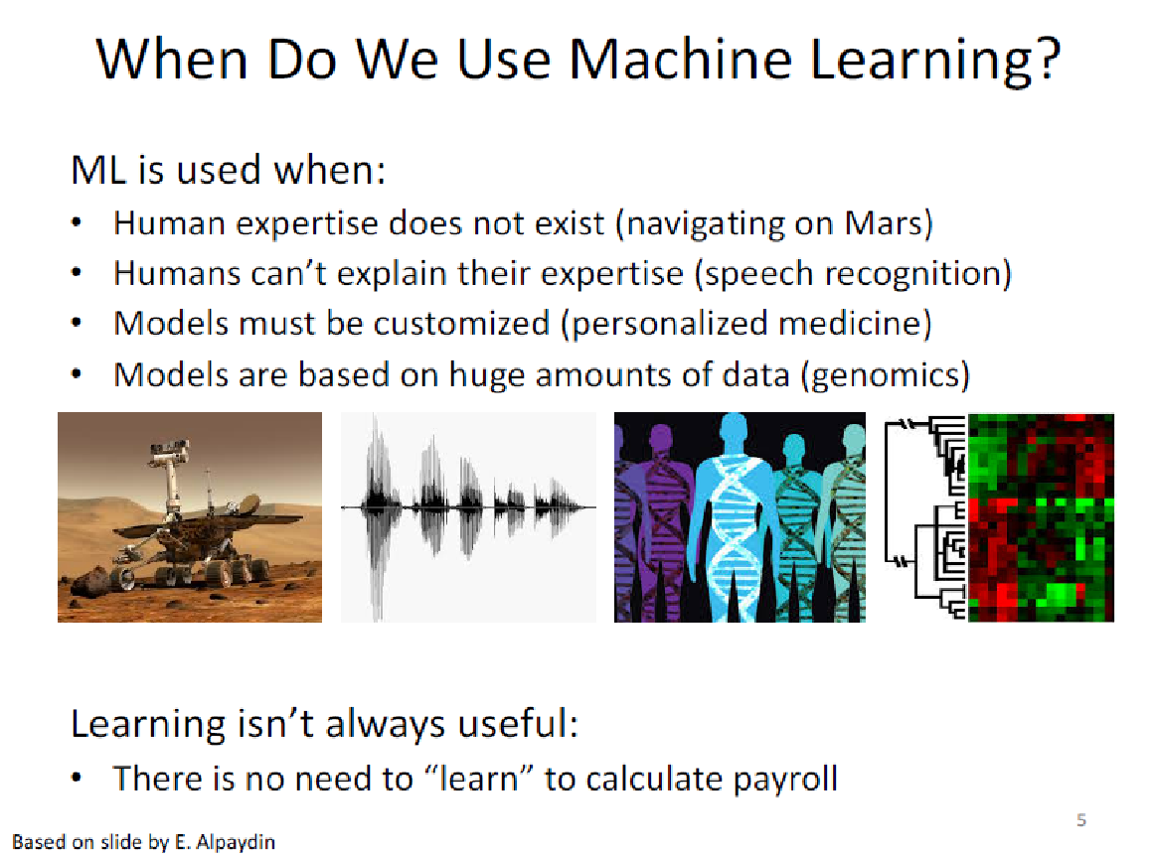

Slide 6
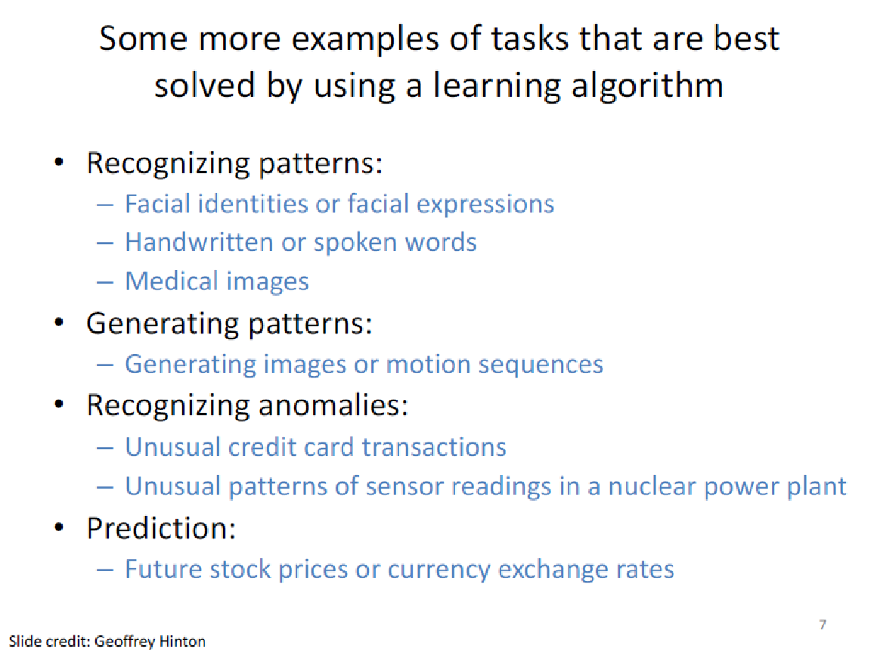

Slide 7
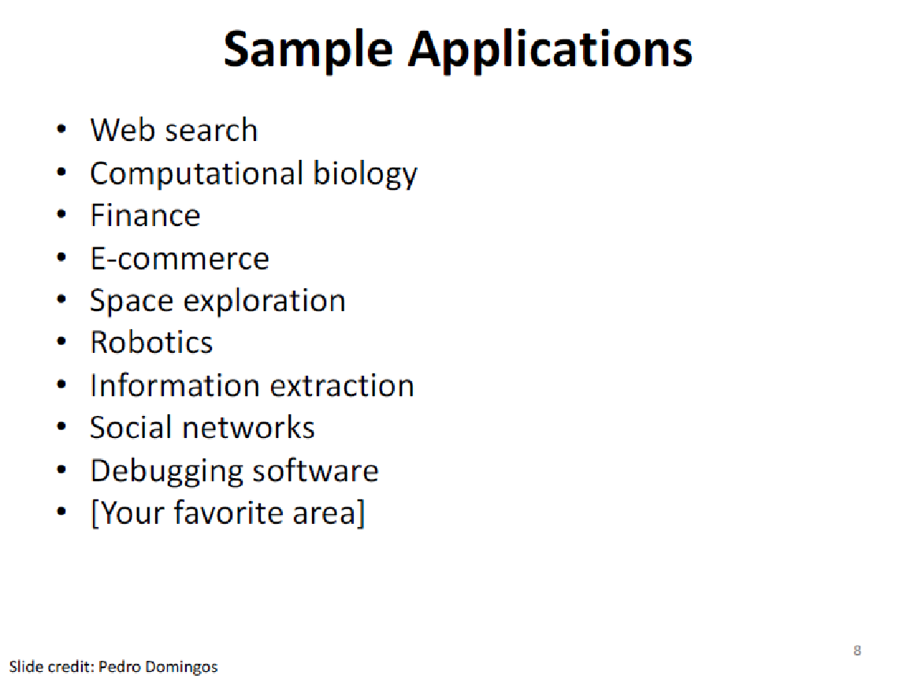

Slide 8
ML State-of-the-Art

Slide 9
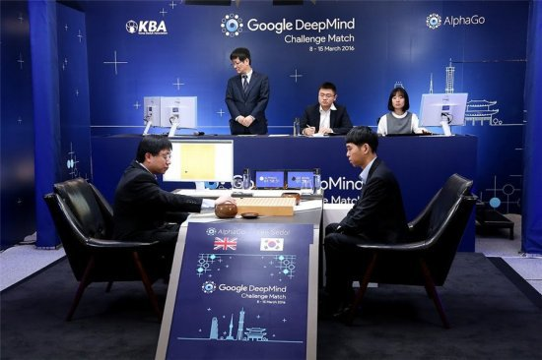

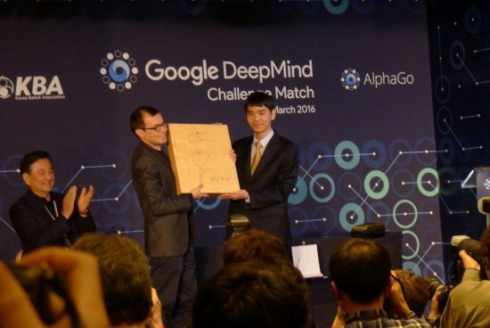
AlphaGo Lee
Vs
Lee Sedol
李世石
黃士傑
李世石
AlphaGo won by 4-1
AlphaGo
A combination of neural network and algorithm
9 and 15 March 2016

Slide 10
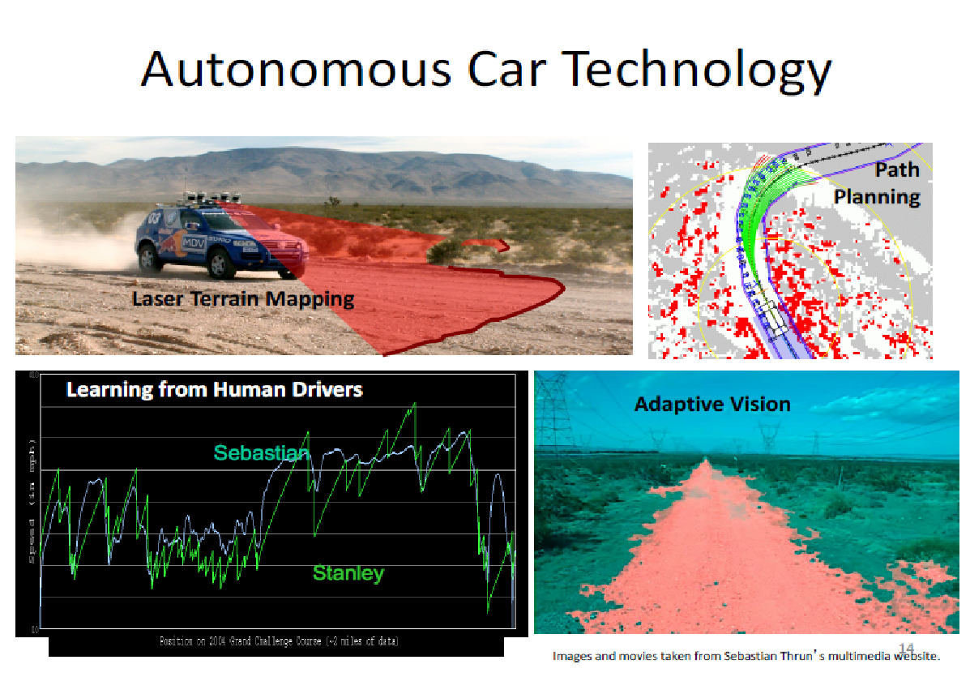

Slide 11
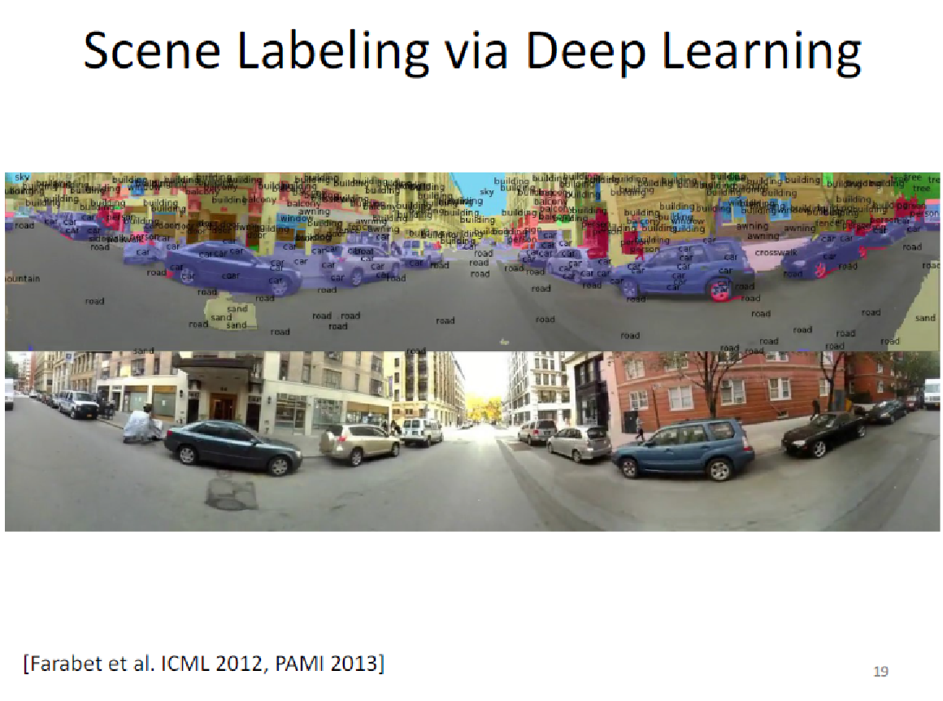

Slide 12
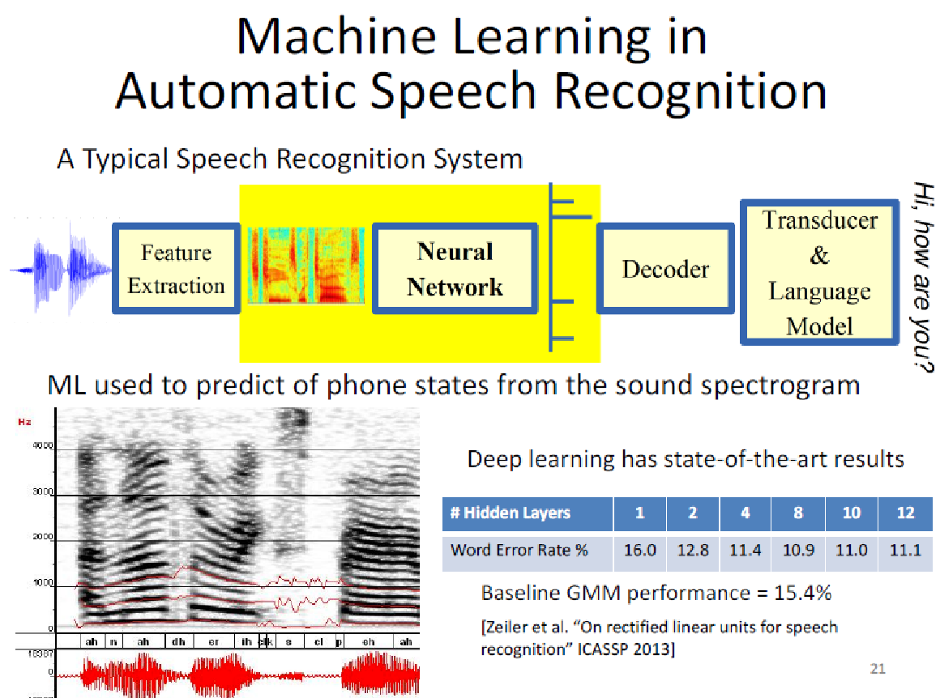

Slide 13
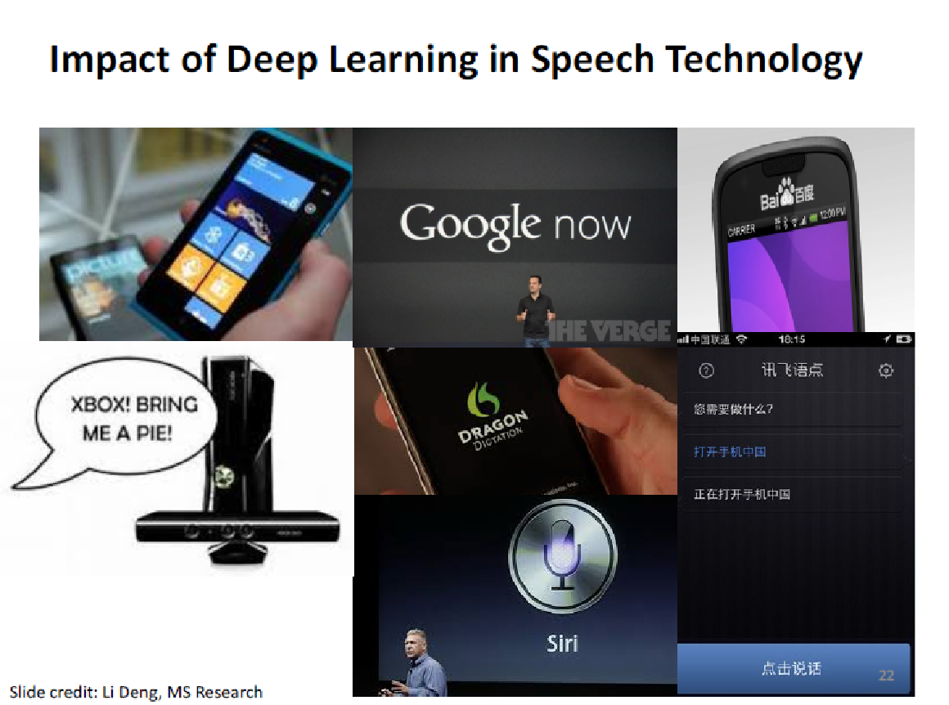

Slide 14


Slide 15
Traditional Programming
Machine Learning
Data
Computer
Output
Program
Data
Computer
Program
Output
Source: https://courses.cs.washington.edu/courses/cse446/09wi/slides/intro.ppt

Slide 16
The Machine Learning Approach
Input
Data
Classifier
ML
e.g. House profiles e.g. cost, location, proximity to schools, safety rating
Prediction (decision to purchase):
Yes / No
Machine Learning
Adapted from: http://www.cbs.dtu.dk/~kerner/GeneDisc_Course_2007_MJK/GeneDiscov_2007_MJK.ppt

Slide 17
Machine Learning Considerations
Learning Task:
What do we want to learn or predict?
Data and assumptions:
What data do we have available?
What is their quality?
What can we assume about the given problem?
Representation:
What is a suitable representation of the examples to be classified?
Method and Estimation:
Are there possible hypotheses?
Can we adjust our predictions based on the given results?
Evaluation:
How well does the method perform?
Might another approach/model perform better?
Adapted from: http://www.cbs.dtu.dk/~kerner/GeneDisc_Course_2007_MJK/GeneDiscov_2007_MJK.ppt

Slide 18
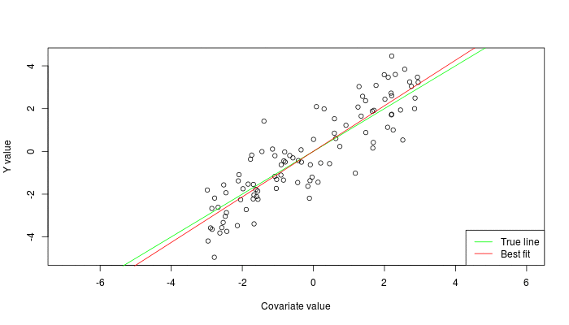


Types of Machine Learning
Supervised: Learning with a labeled training set
Example: email classification with already labeled emails
Unsupervised: Discover patterns in unlabeled data
Example: cluster similar documents based on text
Reinforcement learning: learn to act based on feedback/reward
Example: learn to play Go, reward: win or lose
class A
class A
Classification
Regression
Clustering
Anomaly Detection
Sequence labeling
…
http://mbjoseph.github.io/2013/11/27/measure.html

Slide 19
Machine Learning: Types
Supervised learning
Unsupervised learning

Slide 20
Supervised Learning
Regression

Slide 21
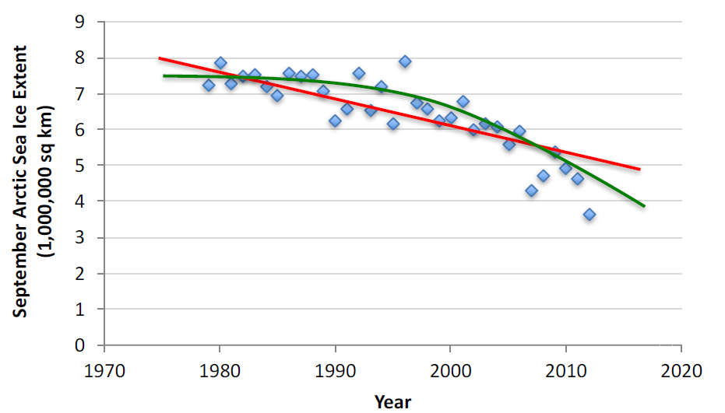
Supervised Learning: Regression
Given (x₁, y₁), (x₂, y₂), ..., (x_{n}, y_{n})
Learn a function f(x) to predict y given x
y is real-valued == regression

Slide 22
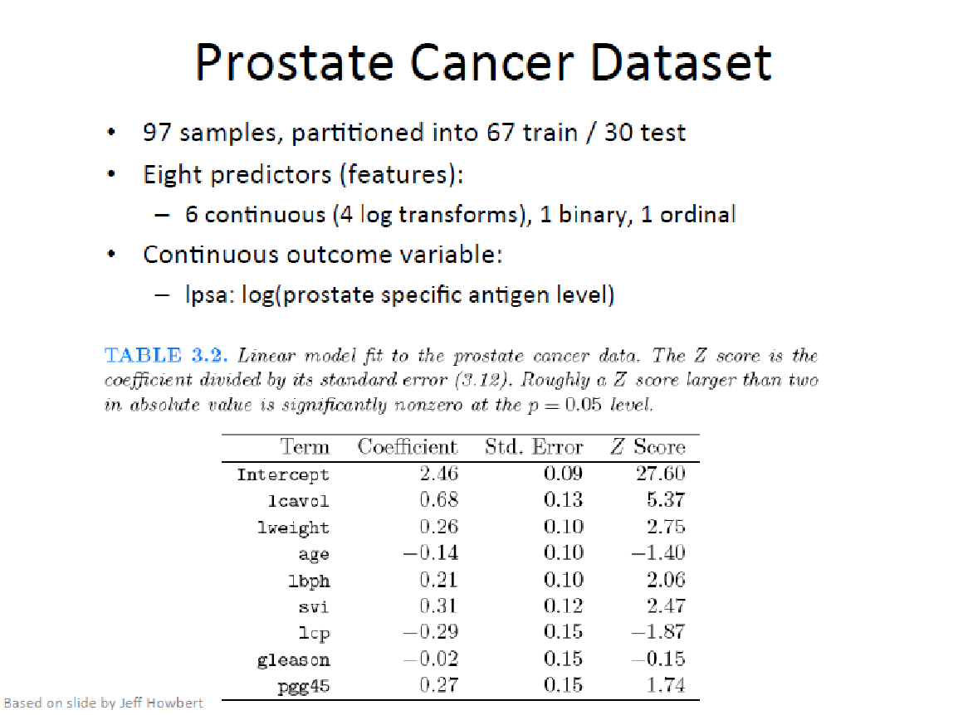

Slide 23
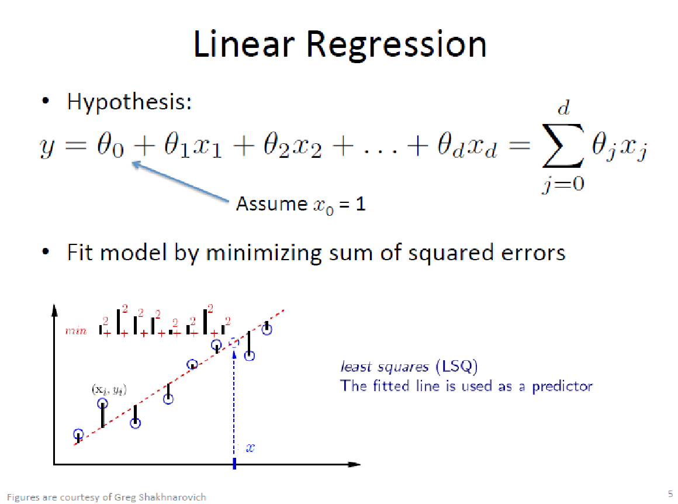

Slide 24
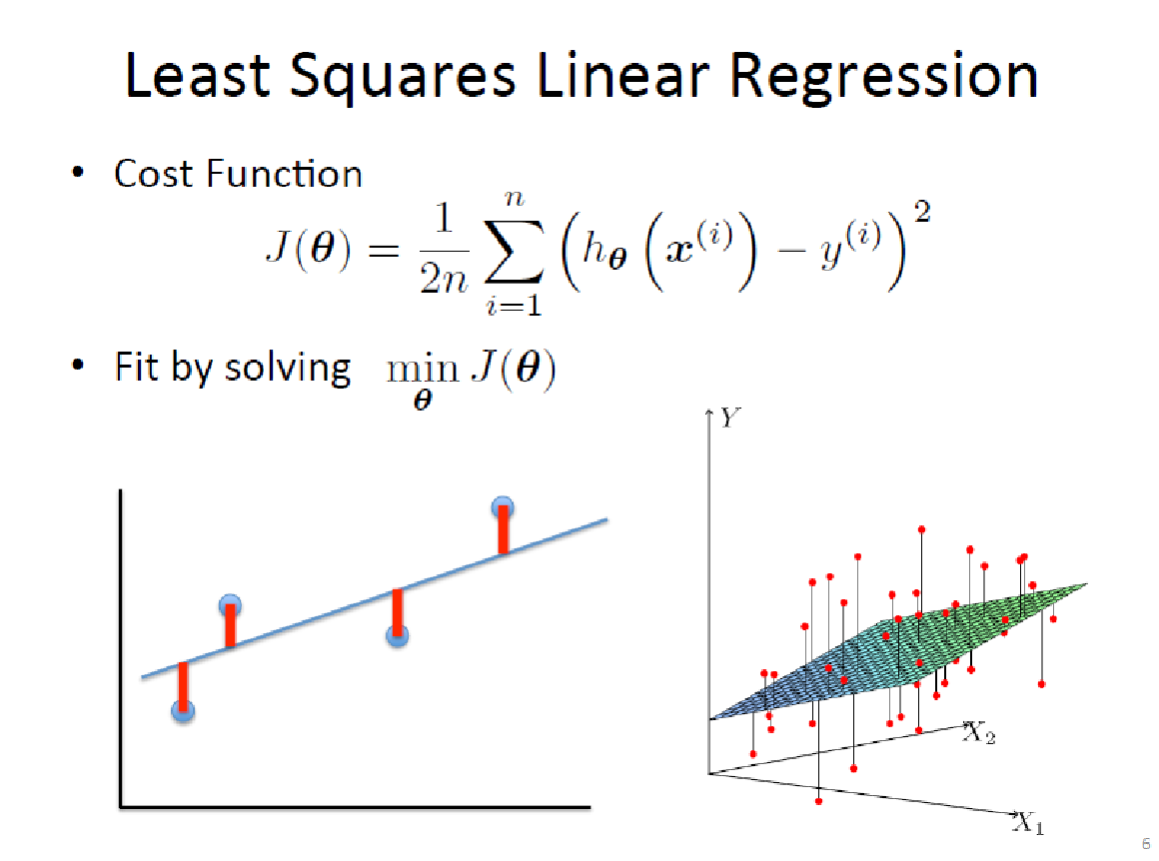

Slide 25
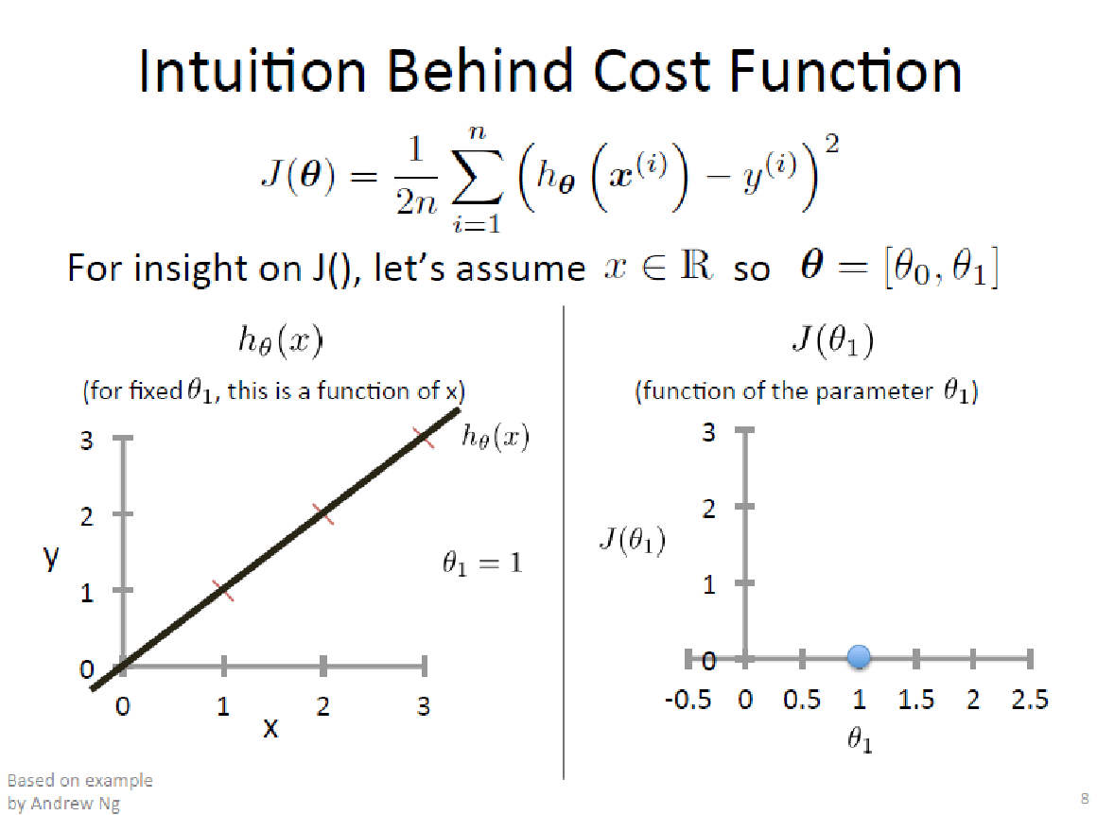

Slide 26
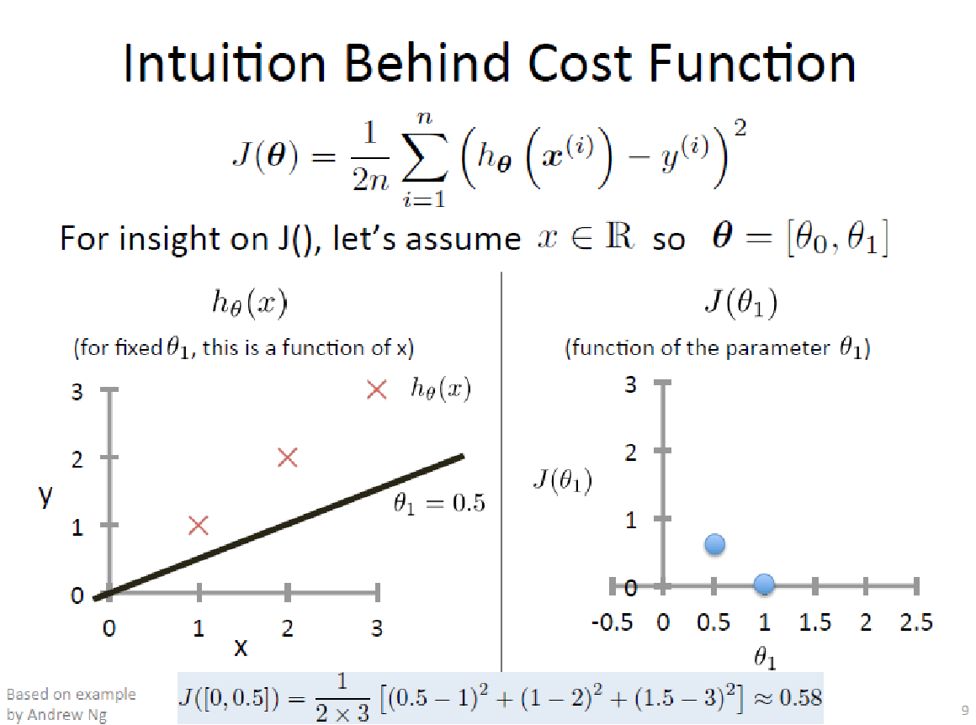

Slide 27
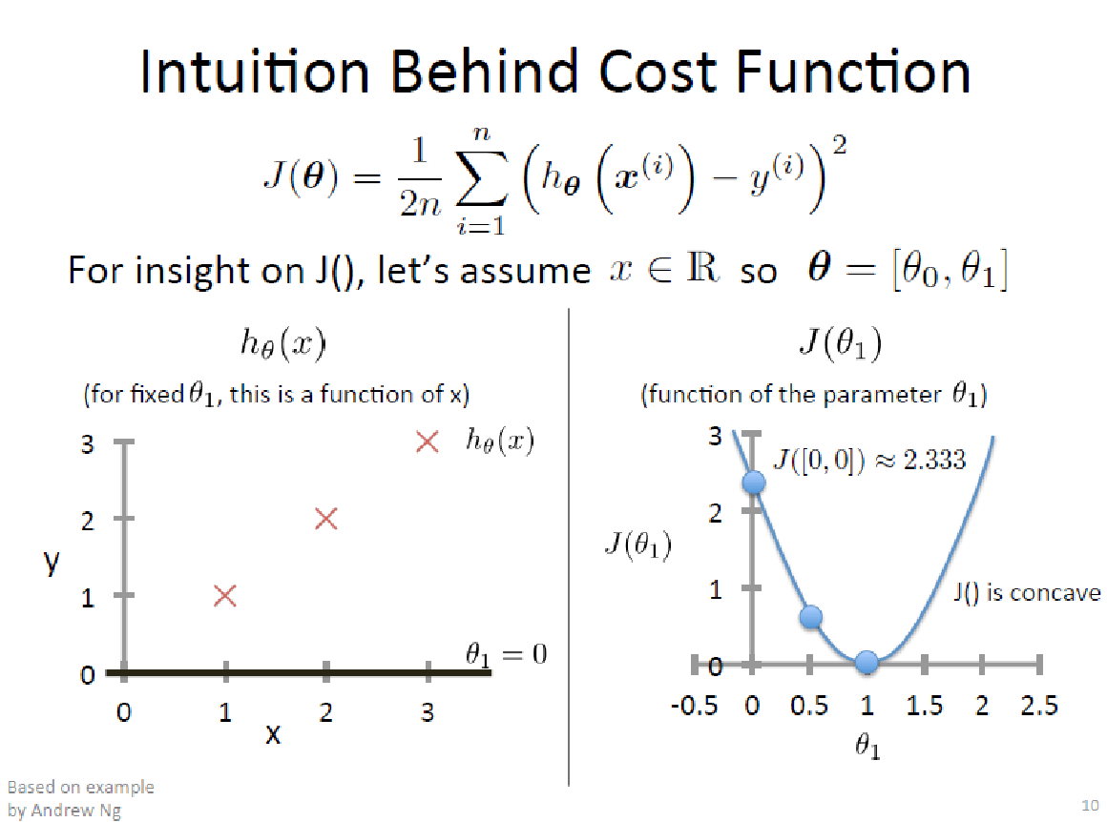

Slide 28
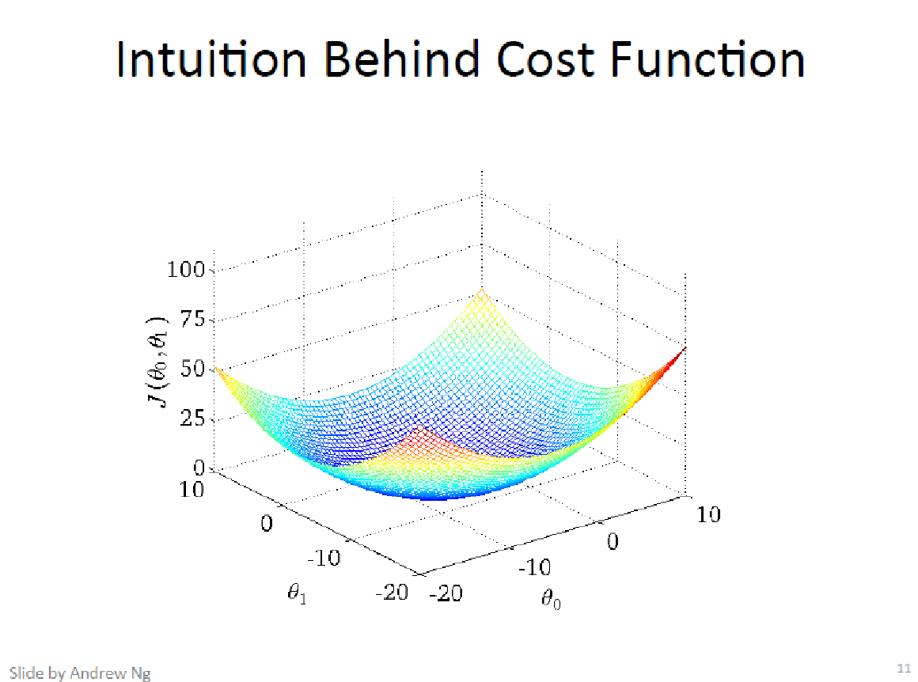
Basis for Gradient Descent

Slide 29
Regression DEMO
DEMO
https://cs.stanford.edu/people/karpathy/convnetjs/demo/regression.html

Slide 30
Supervised Learning
Classification

Slide 31
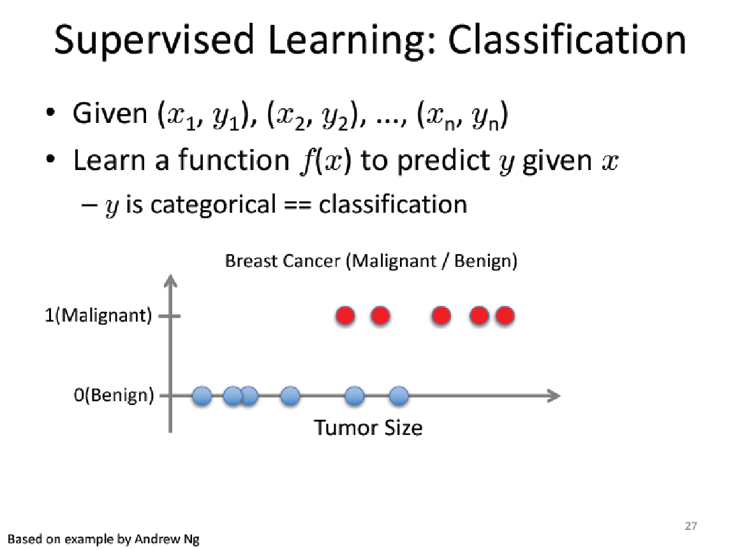

Slide 32
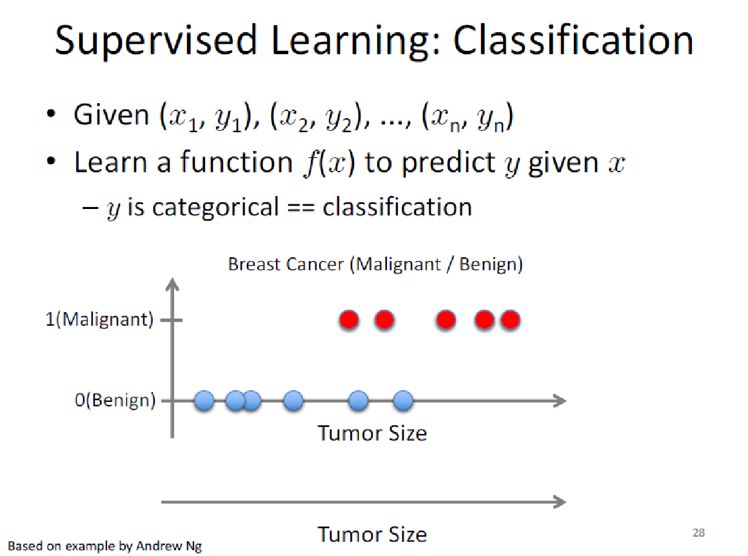

Slide 33
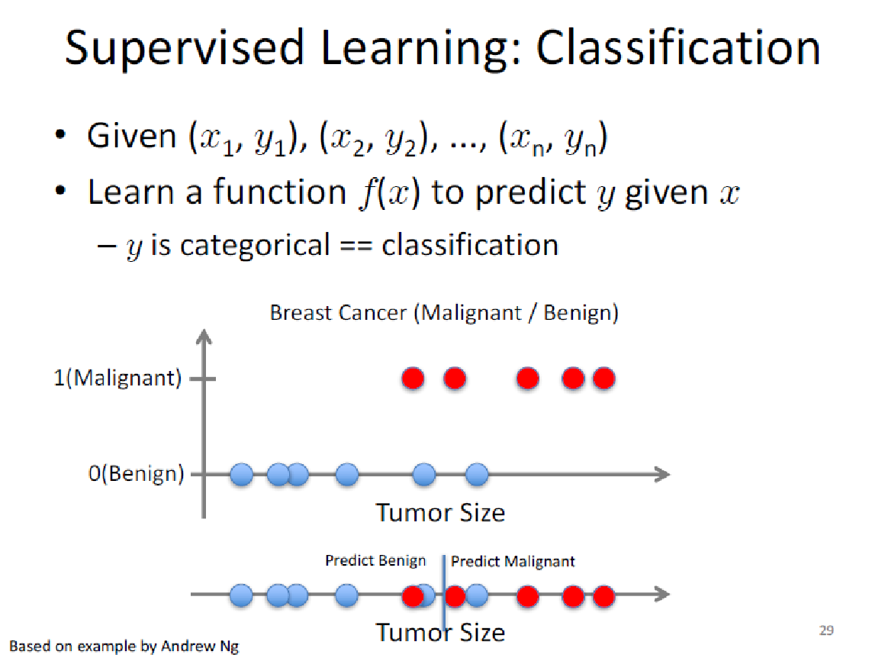

Slide 34
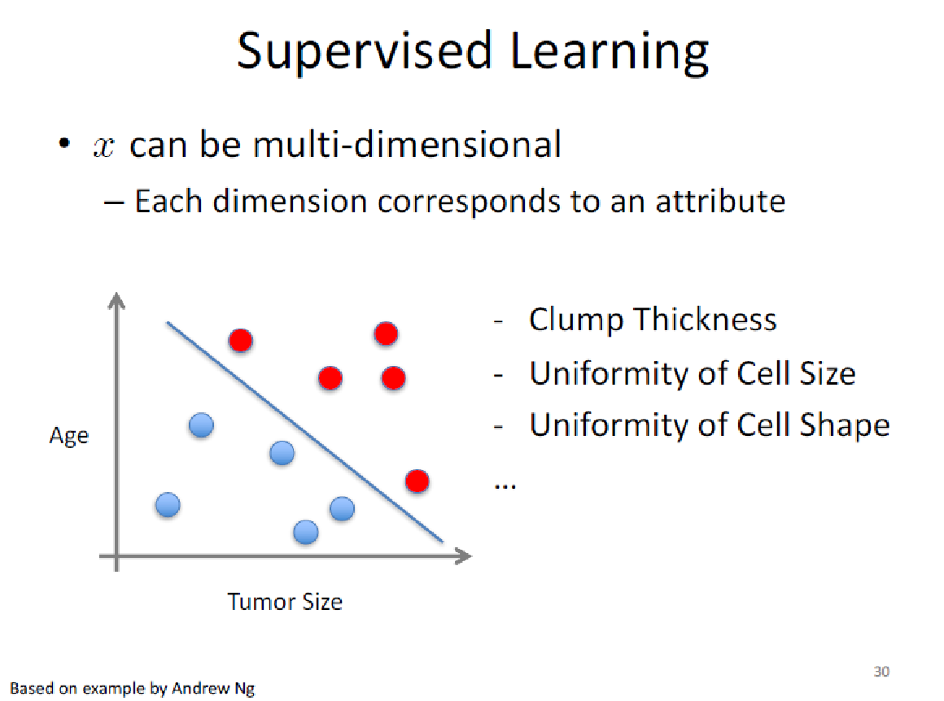
Formulate cost function and solve

Slide 35
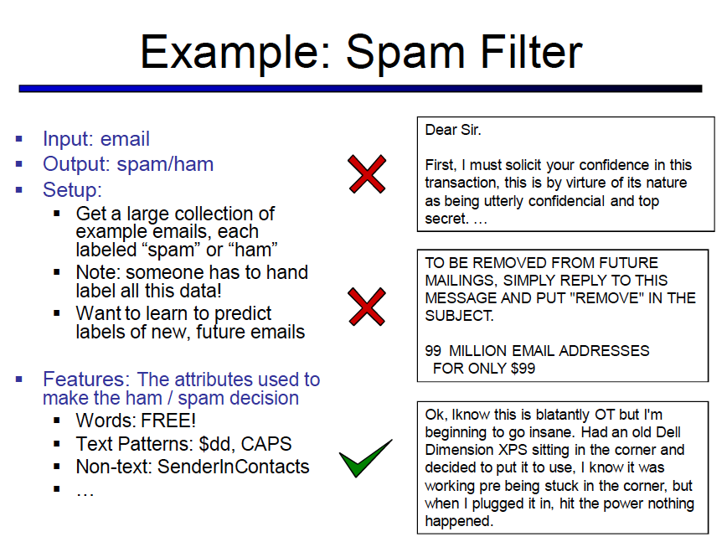
Slide from Dan Klein
Notes:
Classification is used all over the place. one example is spam filtering. So we have an input email and we want the computer to decide whether this email is spam or ham (aka not spam).

Slide 36
Slide from Dan Klein
Notes:
What a classification scheme will do is use a bunch of labeled data – where some person has gone in and hand labeled a bunch of emails as either spam or ham. Then the classifier has to learn how to predict the labels of new, future emails.

Slide 37
Slide from Dan Klein
Notes:
The classifier will do this based on a represenation extracted from the text that might be useful for making the ham/spam decision. What kinds of features do you think might be useful?

Slide 38
Slide from Dan Klein
Notes:
Things like words that are particularly “spamy”, text patterns like putting words in all caps, non text patterns like the sender is in your contacts list might indicate that the email is not spam. How do spammers get around this? Lots of ways including embedding the spam message in lots of basically gibberish that looks like real text, adding personalized text or subject lines, creative misspellings,

Slide 39
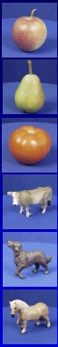
Example: Image classification
input
desired output
apple
pear
tomato
cow
dog
horse
Slide credit: Svetlana Lazebnik
Notes:
or we might have an image classification problem where we want to recognize input images as different categories of objects – apple, pear, dog and so on.

Slide 40
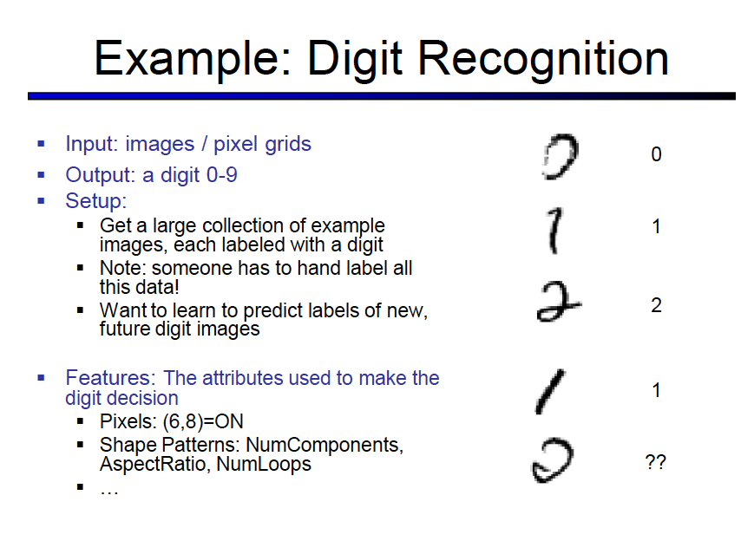
http://yann.lecun.com/exdb/mnist/index.html
Slide from Dan Klein
Notes:
another example is digit recognition – something the USPS uses for extracting hand written zip codes from letters to automate some hand processing of mail. Here the input is an image of a digit and your classifier has to output which digit is is. Here the input is images of hand written digits and we want to predict which digit has been written. These examples are from the mnist database – 60k examples of hand written digits.
So the set up is you’re given a bunch of digits with ground truth labels for each digit and you want to learn from these examples in order to predict well for a future unobserved sample. The first thing you have to decide is representation – what kinds of features to use for the problem (how to represent the digit in your algorithm). Here you might just use something as simple as the pixel grid itself. Or measurements of how curvy the digit is or how many loops and so on.

Slide 41
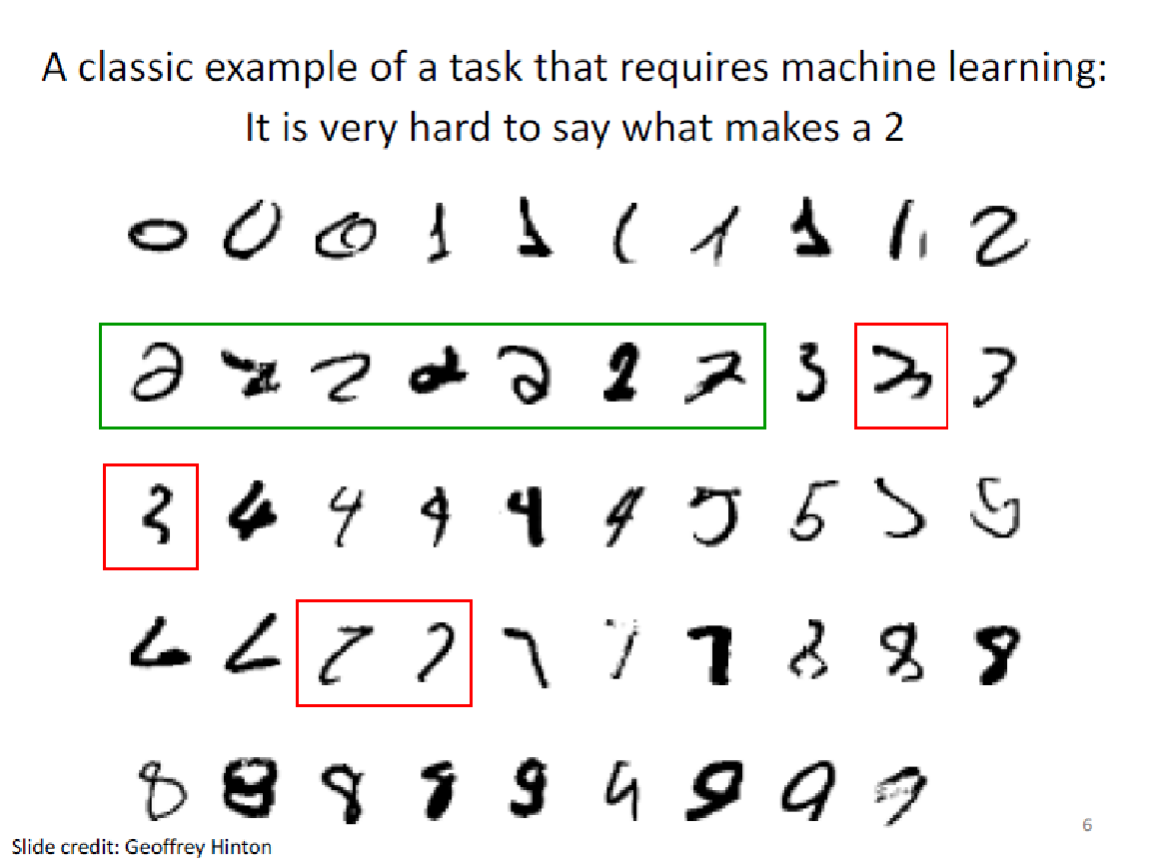

Slide 42
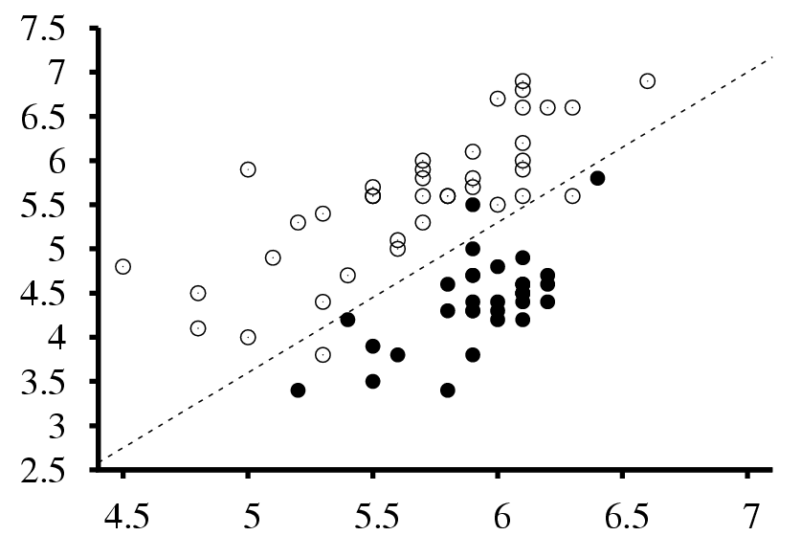
Example: Seismic data
Earthquakes
Surface wave magnitude
Nuclear explosions
Body wave magnitude
Slide credit: Svetlana Lazebnik
Notes:
There are many many more examples, including scientific classification tasks, such as predicting whether an event is an earthquake or nuclear explosion. Here features are wave magnitudes and we need to make a prediction of which category an event falls into.

Slide 43
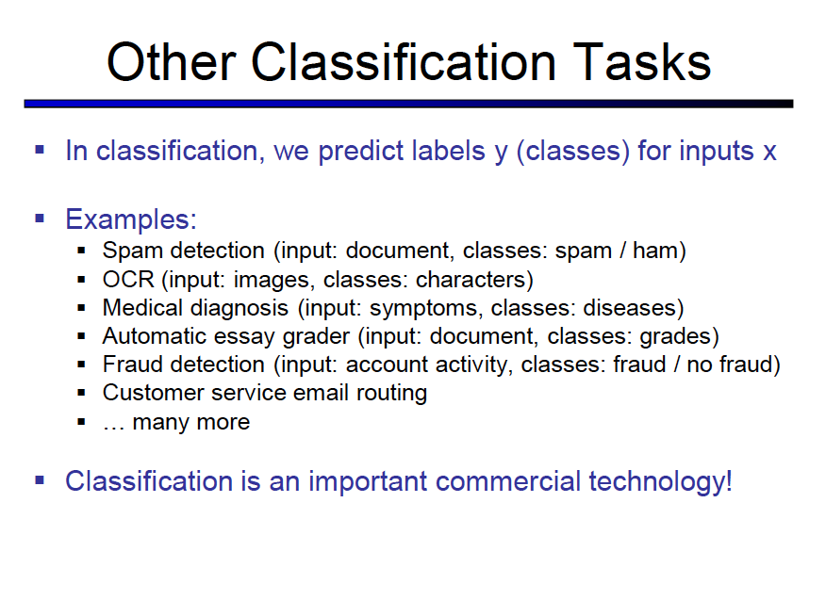
Slide from Dan Klein
Notes:
Fraud detection – how do you detect if someone is fudging the numbers? People are not very good at generating random numbers! They tend to repeat digits less often than what would appear randomly so you can analyze the randomness of a set of numbers and if it’s not very random then this might be a case of fraud.

Slide 44
The basic classification framework
y = f(x)
Learning: given a training set of labeled examples {(x₁,y₁), …, (x_{N},y_{N})}, estimate the parameters of the prediction function f
Inference: apply f to a never before seen test example x and output the predicted value y = f(x)
output
classification function
input
Slide credit: Svetlana Lazebnik
Notes:
In classification the goal is to learn a function f which maps from inputs, x, to output labels, y from a training set of labeled examples. During inference (at test time) we apply f to a never before seen example and output the predicted value y=f(x). we can measure the effectiveness of our method by how well we can predict y’s for unseen x’s.
What are some examples of x for images?
color histograms, tiny images, histogram of visual words, … and many more.
How about Y? could be object class label, or digit or…

Slide 45
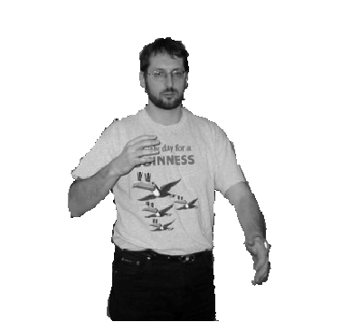
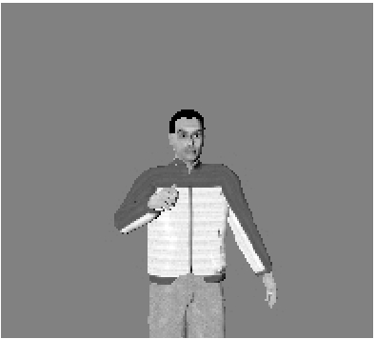
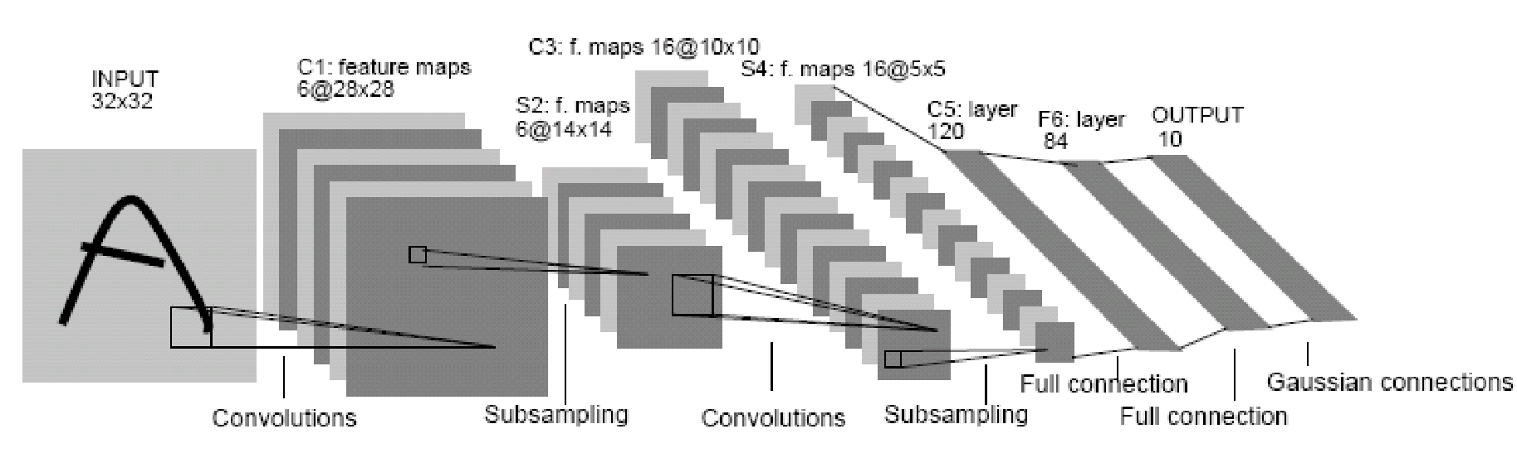
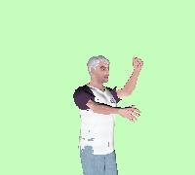
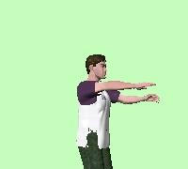
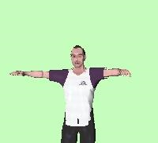
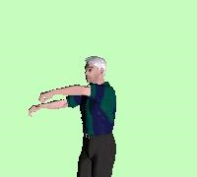
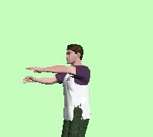
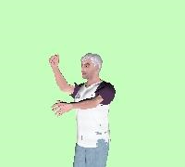
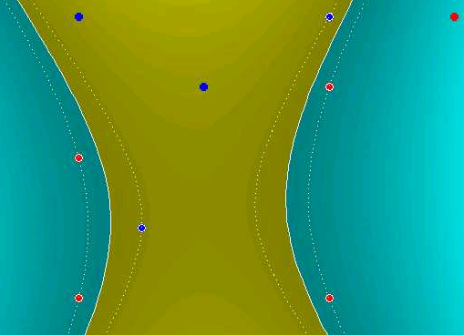
Some ML classification methods
Nearest neighbor
Neural networks
10⁶ examples
LeCun, Bottou, Bengio, Haffner 1998
Rowley, Baluja, Kanade 1998
…
Shakhnarovich, Viola, Darrell 2003
Berg, Berg, Malik 2005
…
Support Vector Machines and Kernels
Conditional Random Fields
Guyon, Vapnik
Heisele, Serre, Poggio, 2001
…
McCallum, Freitag, Pereira 2000
Kumar, Hebert 2003
…
Slide credit: Antonio Torralba
Notes:
Many more references missing here. These are big fields on its own.
Big emphasis in the past on face detection and character recognition.
It provided a clear problem with a well defined visual category and many applications. It allowed making progress on efficient techniques.

Slide 46

Example: Training and testing
Training set (labels known)
Test set (labels unknown)
Key challenge: generalization to unseen examples
Slide credit: Svetlana Lazebnik

Slide 47
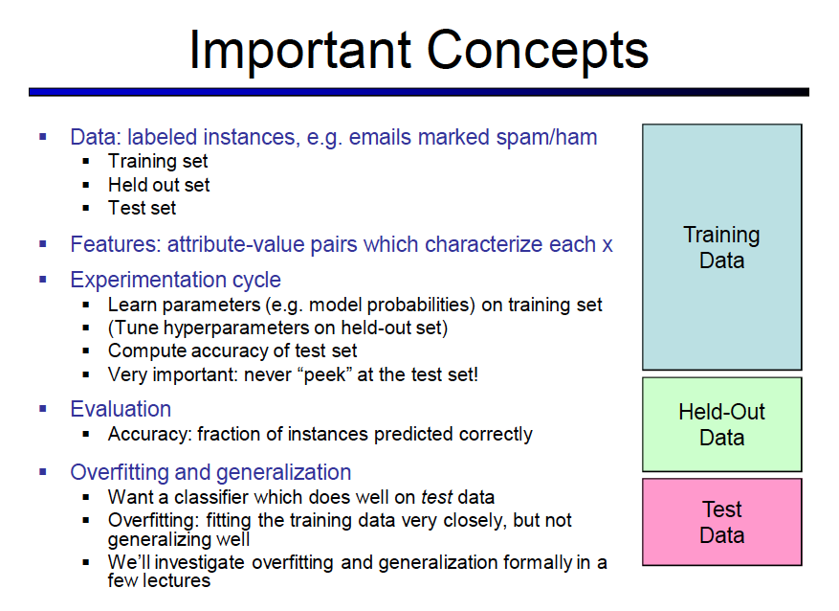
Slide credit: Dan Klein
Notes:
Some important concepts to be aware of for all machine learning classifiers are that your data is usually separated into 3 parts, training data, held-out data and test data.
The training data is all of the previous data examples that you’ve been given to learn your classifier from.
Held out data is a set of data on which you can try things out – maybe tune whatever parameters of your model you might have.
Lastly you have test data. This data you keep aside until the very end. Here is where you can evaluate your final classification model ie you look at how well your model does at labeling this previously unseen data. It’s very important to never peek at the test set because this will affect how well you can model the performance of your classifier.

Slide 48
Classification
DEMO 1
https://cs.stanford.edu/people/karpathy/convnetjs/demo/classify2d.html
DEMO 2
https://playground.tensorflow.org/

Slide 49
Unsupervised Learning

Slide 50
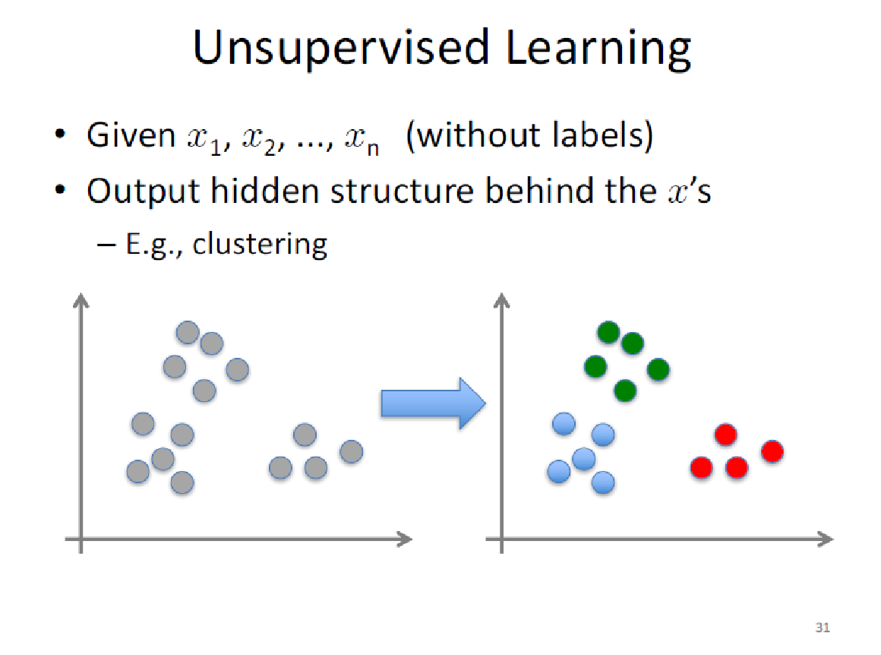

Slide 51
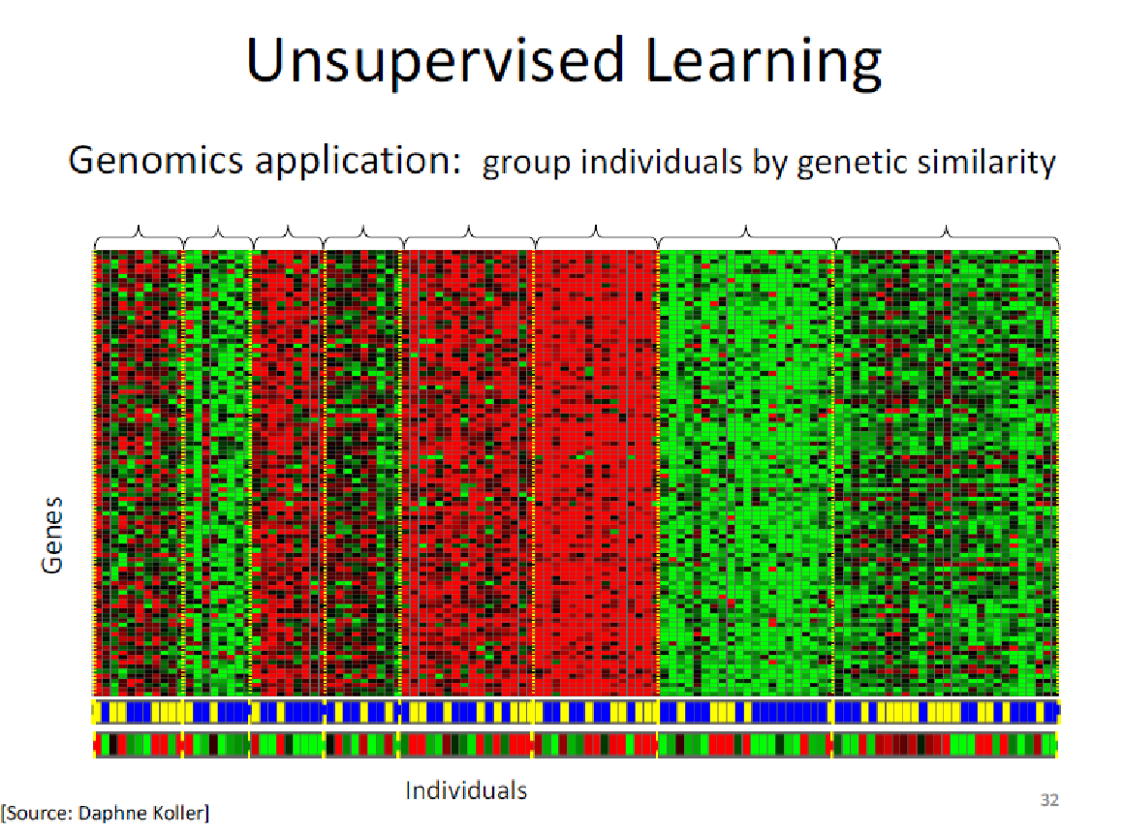

Slide 52
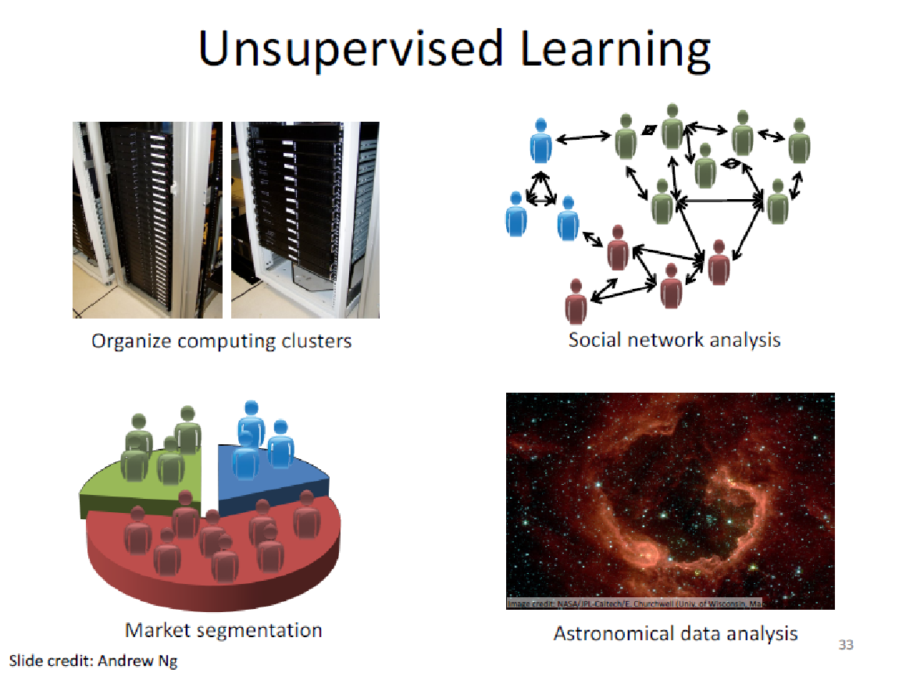

Slide 53
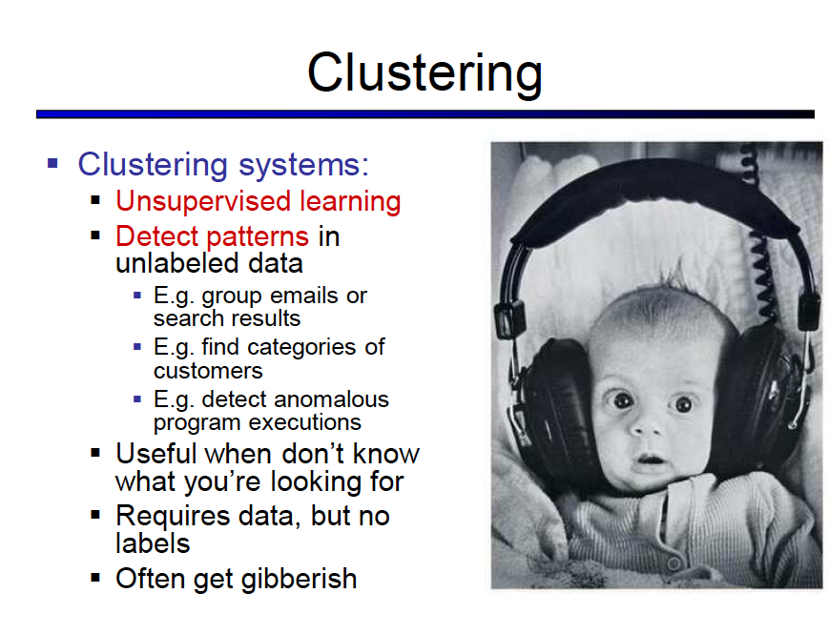

Slide 54
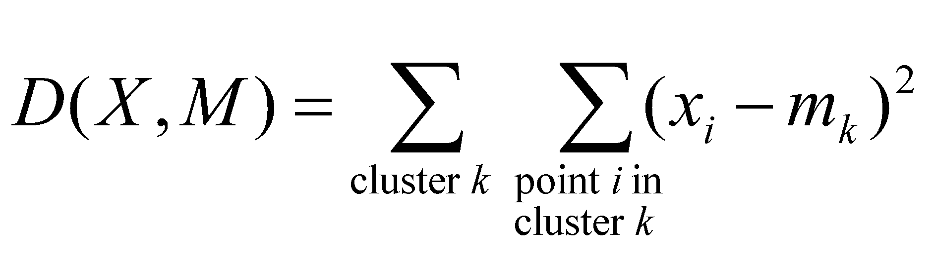
K-means clustering
Want to minimize sum of squared Euclidean distances between points x_{i} and their nearest cluster centers m_{k}
Algorithm:
Randomly initialize K cluster centers
Iterate until convergence:
Assign each data point to the nearest center
Recompute each cluster center as the mean of all points assigned to it
source: Svetlana Lazebnik
Notes:
One of the most commonly used clustering algorithms is k means clustering where you’re trying to minimize SSD between points and their nearest cluster center.
The algorithm proceeds as you randomly initialize k cluster centers, assign each data point to the nearest center, update the cluster centers as the mean of all points assigned to it and iterate this until convergence.

Slide 55
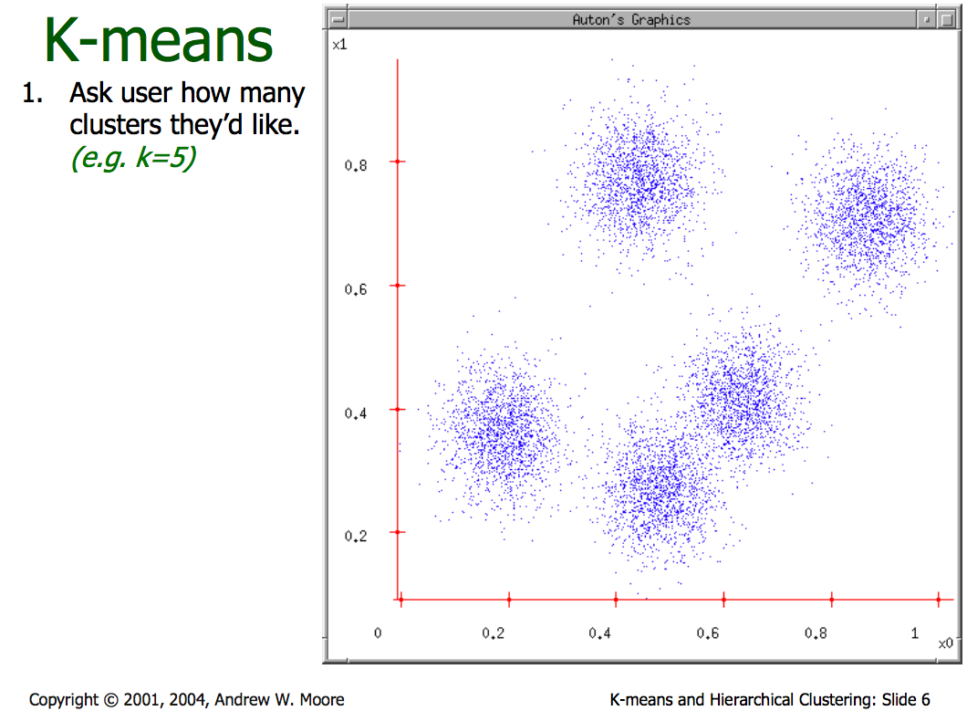
Notes:
So kmeans would proceed as follows if the user has specified k=5

Slide 56
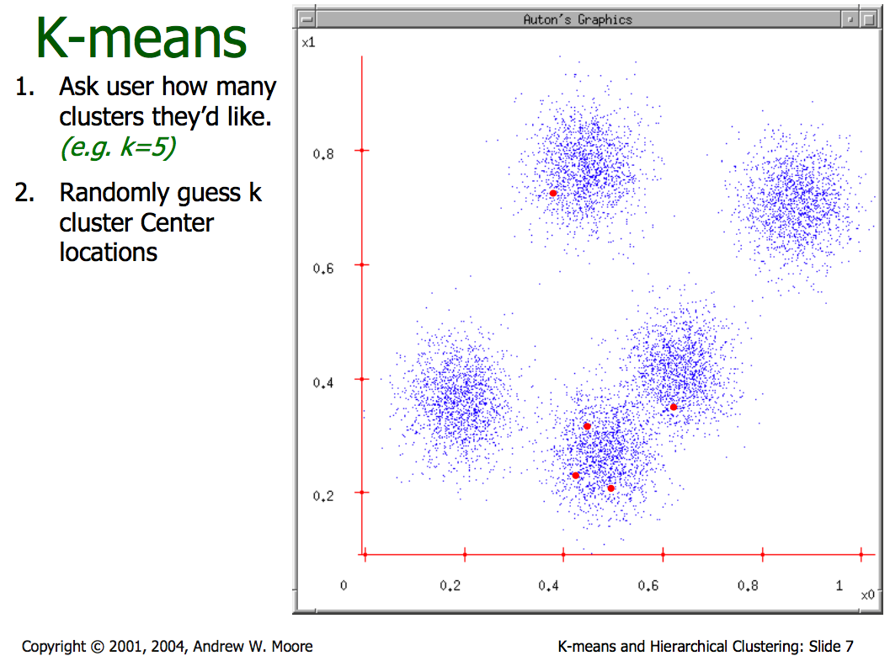
Notes:
Randomly select k cluster centers.

Slide 57
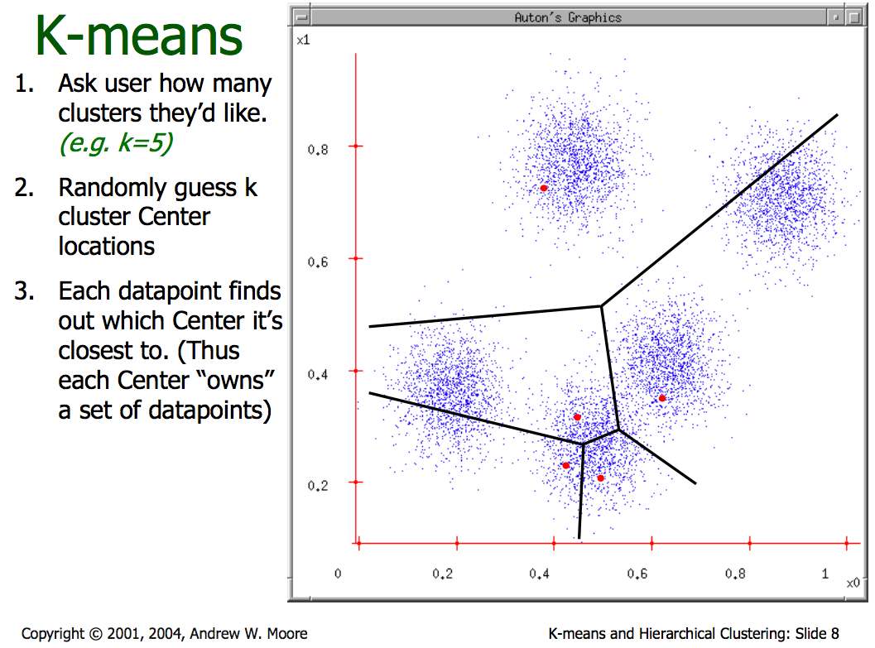
Notes:
Assign each data point to the closest cluster center.

Slide 58
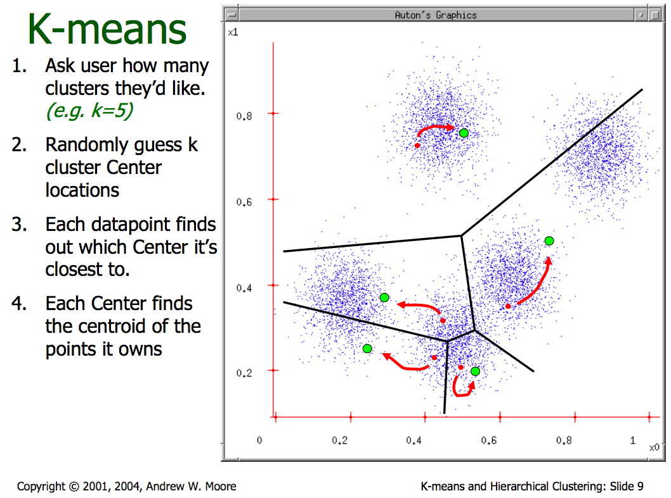
Notes:
Update the cluster centers as the mean of all points assigned to it.

Slide 59
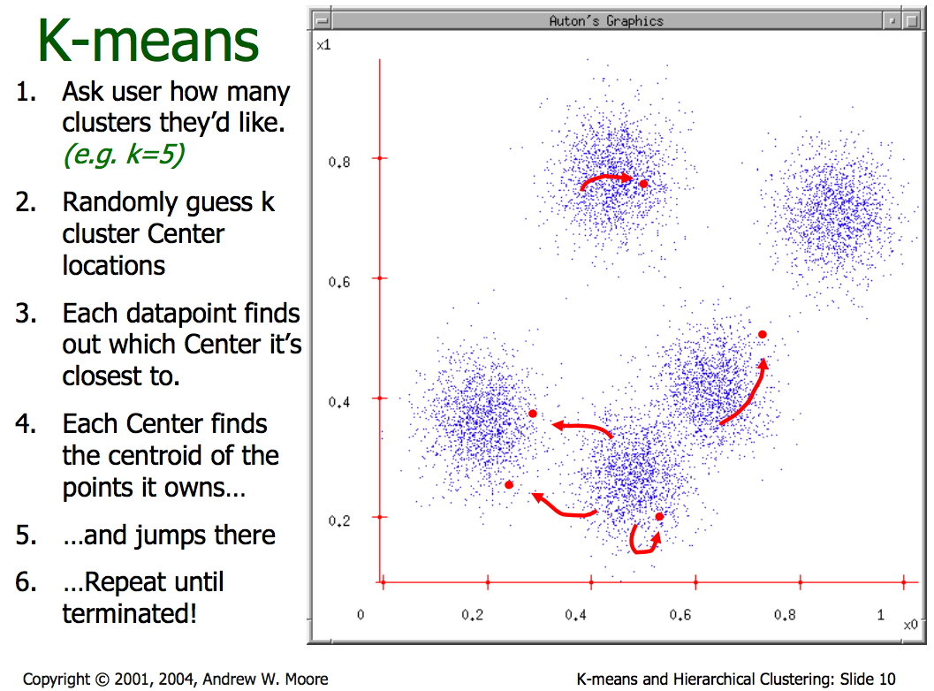
Notes:
Then iterate this until convergence.

Slide 60


Slide 61


Slide 62


Slide 63


Slide 64


Slide 65

Notes:
Voila!

Slide 66
K-means: try-it-out yourself
https://www.naftaliharris.com/blog/visualizing-k-means-clustering/
http://tech.nitoyon.com/en/blog/2013/11/07/k-means/
For best results try
Randomly -> Gaussian Mixture

Slide 67
Deep Learning

Slide 68


ML vs. Deep Learning
Most machine learning methods work well because of human-designed representations and input features
ML becomes just optimizing weights to best make a final prediction

Slide 69

What is Deep Learning (DL) ?
A machine learning subfield of learning representations of data. Exceptional effective at learning patterns.
Deep learning algorithms attempt to learn (multiple levels of) representation by using a hierarchy of multiple layers
If you provide the system tons of information, it begins to understand it and respond in useful ways.
https://www.xenonstack.com/blog/static/public/uploads/media/machine-learning-vs-deep-learning.png

Slide 70

Why is DL useful?
Manually designed features are often over-specified, incomplete and take a long time to design and validate
Learned Features are easy to adapt, fast to learn
Deep learning provides a very flexible, (almost?) universal, learnable framework for representing world, visual and linguistic information.
Can learn both unsupervised and supervised
Effective end-to-end joint system learning
Utilize large amounts of training data
In ~2010 DL started outperforming other ML techniques
first in speech and vision, then NLP

Slide 71


State of the art in …
Several big improvements in recent years in NLP
Machine Translation
Sentiment Analysis
Dialogue Agents
Question Answering
Text Classification …
Leverage different levels of representation
words & characters
syntax & semantics

Slide 72
Performance vs Sample Size
Deep Learning algorithms
Performance
Traditional ML algorithms
Size of Data

Slide 73



Artificial Neural Networks Basics
-0.06
W1
-2.5
W2
f(x)
W3
1.4
Deep Learning is based on the concept of ANNs

Slide 74
-0.06
2.7
-2.5
-8.6
f(x)
0.002
x = -0.06×2.7 + 2.5×8.6 + 1.4×0.002 = 21.34
1.4

Slide 75

A dataset
Fields class
1.4 2.7 1.9 0
3.8 3.4 3.2 0
6.4 2.8 1.7 1
4.1 0.1 0.2 0
etc …

Slide 76
Training the neural network
Fields class
1.4 2.7 1.9 0
3.8 3.4 3.2 0
6.4 2.8 1.7 1
4.1 0.1 0.2 0
etc …

Slide 77
Training data
Fields class
1.4 2.7 1.9 0
3.8 3.4 3.2 0
6.4 2.8 1.7 1
4.1 0.1 0.2 0
etc …
Initialise with random weights

Slide 78
Training data
Fields class
1.4 2.7 1.9 0
3.8 3.4 3.2 0
6.4 2.8 1.7 1
4.1 0.1 0.2 0
etc …
Present a training pattern
1.4
2.7
1.9

Slide 79
Training data
Fields class
1.4 2.7 1.9 0
3.8 3.4 3.2 0
6.4 2.8 1.7 1
4.1 0.1 0.2 0
etc …
Feed it through to get output
1.4
2.7 0.8
1.9

Slide 80
Training data
Fields class
1.4 2.7 1.9 0
3.8 3.4 3.2 0
6.4 2.8 1.7 1
4.1 0.1 0.2 0
etc …
Compare with target output
1.4
2.7 0.8
0
1.9 error 0.8

Slide 81


Training data
Fields class
1.4 2.7 1.9 0
3.8 3.4 3.2 0
6.4 2.8 1.7 1
4.1 0.1 0.2 0
etc …
Adjust weights based on error
1.4
2.7 0.8
0
1.9 error 0.8

Slide 82
Training data
Fields class
1.4 2.7 1.9 0
3.8 3.4 3.2 0
6.4 2.8 1.7 1
4.1 0.1 0.2 0
etc …
Present a training pattern
6.4
2.8
1.7

Slide 83
Training data
Fields class
1.4 2.7 1.9 0
3.8 3.4 3.2 0
6.4 2.8 1.7 1
4.1 0.1 0.2 0
etc …
Feed it through to get output
6.4
2.8 0.9
1.7

Slide 84
Training data
Fields class
1.4 2.7 1.9 0
3.8 3.4 3.2 0
6.4 2.8 1.7 1
4.1 0.1 0.2 0
etc …
Compare with target output
6.4
2.8 0.9
1
1.7 error -0.1

Slide 85
Training data
Fields class
1.4 2.7 1.9 0
3.8 3.4 3.2 0
6.4 2.8 1.7 1
4.1 0.1 0.2 0
etc …
Adjust weights based on error
6.4
2.8 0.9
1
1.7 error -0.1

Slide 86
Training data
Fields class
1.4 2.7 1.9 0
3.8 3.4 3.2 0
6.4 2.8 1.7 1
4.1 0.1 0.2 0
etc …
And so on ….
6.4
2.8 0.9
1
1.7 error -0.1
Repeat this thousands, maybe millions of times – each time
taking a random training instance, and making slight
weight adjustments
Algorithms for weight adjustment are designed to make
changes that will reduce the error

Slide 87

Supervised Learning
Traditional pattern recognition models work with hand crafted features and relatively simple trainable classifiers.
Limitations
Very tedious and costly to develop hand crafted features.
The hand-crafted features are usually highly dependents on one application.
Trainable Classifier
(e.g. SVM, Random Forrest)
Output
(e.g. Outdoor Yes or No)
Extract Hand Crafted Features

Slide 88





















Deep Learning
Deep learning has an inbuilt automatic multi stage feature learning process that learns rich hierarchical representations (i.e. features).
Low Level Features
Mid Level Features
High Level Features
Trainable Classifier
Output
(e.g. outdoor, indoor)

Slide 89
Convnet Online Demo
https://cs.stanford.edu/people/karpathy/convnetjs/demo/mnist.html

Slide 90

Automatic Colorization of Black and White Images

Slide 91



Modeling Sequences
A person riding a motorbike on dirt road
Image Captioning
Positive
Awesome tutorial.
Sentiment Analysis
Happy
Diwali
Machine Translation
शुभ
दीपावली

Slide 92
What are RNNs?
Recurrent neural networks have the ability to selectively pass information across sequence steps, while processing sequential data one element at a time.
Allow a memory of the previous inputs to persist in the model’s internal state and influence the outcome.
OUTPUT
h(t)
h(t)
Hidden Layer
Delay
x(t)
h(t-1)
INPUT

Slide 93

Visual Question Answering: RNNs + CNNs

Slide 94











Computer Aided Diagnosis and Interventions (CADI) Lab
Surgical tool (needles, guidewires, catheters, atherectomy devices) enhancement and automatic tip localization in image-guided interventions (biopsies, cardiovascular interventions, regional anesthesia, fetal interventions)
Conventional ultrasound
Needle tip
Guidewire tip
Portable ultrasound
3D ultrasound
Fluoroscopy
Transesophageal
ultrasound
Dr. Mwikirize, CEDAT

Slide 95




A Portable, Deep Learning-based Diagnostic Platform for Plant Diseases
A low-cost, portable platform for diagnosing passion fruit (and other plant) diseases
Recipient of an NVIDIA Corporation GPU seeding grant
http://www.netlabsug.org/
Dr. Serugunda, Dr. Katumba

Slide 96

Diagnosis of Cervical Cancer
Applying machine learning to classification of images of cervical cancer
Dr. Hanifa Nabuuma

Slide 97
Practical ML

Slide 98
ML in Practice
Understanding domain, prior knowledge, and goals
Data integration, selection, cleaning, pre-processing, etc.
Learning models
Interpreting results
Consolidating and deploying discovered knowledge
Loop

Slide 99

Machine Learning Frameworks

Slide 100
Hands-on ML
Come to the afternoon session
Starts 2.30pm
Same venue as Session 1
Can carry your own laptop (**OPTIONAL**)

Slide 101
Other Links
https://playground.tensorflow.org/
https://www.deeplearningbook.org/

Slide 102
END

Slide 103
Python Check
Program Files -> Anaconda3 -> Spyder
Enter 1 + 1
Run

